Slide 1
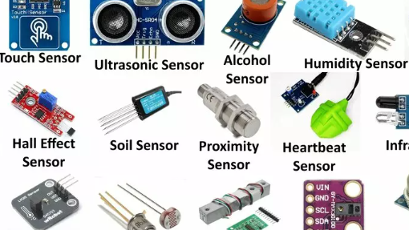
EG431D Data Acquisition
Sensors

Slide 2
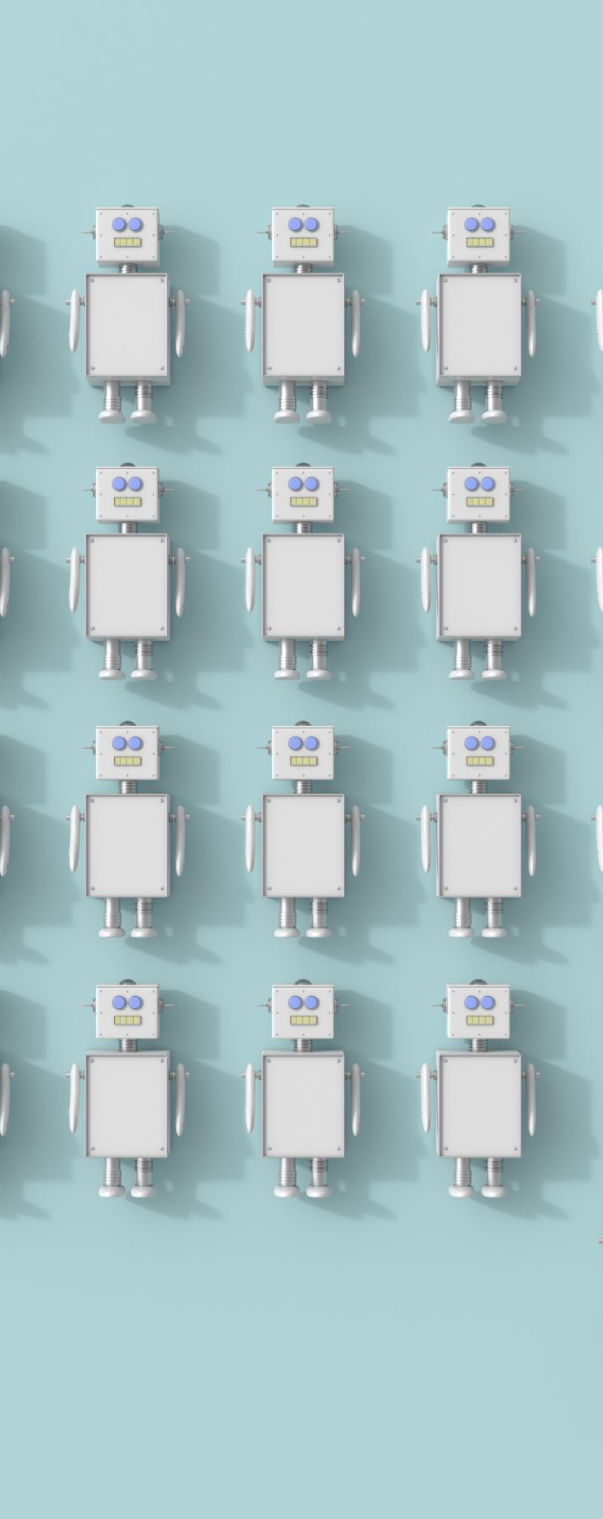
Objectives
Gain familiarity with various types of sensors and their applications.
Understand how to integrate analogue and digital sensors with MCUs.
Explore advancements in sensor technologies.
Develop practical skills in sensor interfacing and application programming.

Slide 3

Overview of Sensors
Definition: Devices that detect, measure, and relay information about physical or environmental parameters.
Components: Sensing element and transducer.
Applications: IoT, industrial automation, healthcare, transportation.

Slide 4
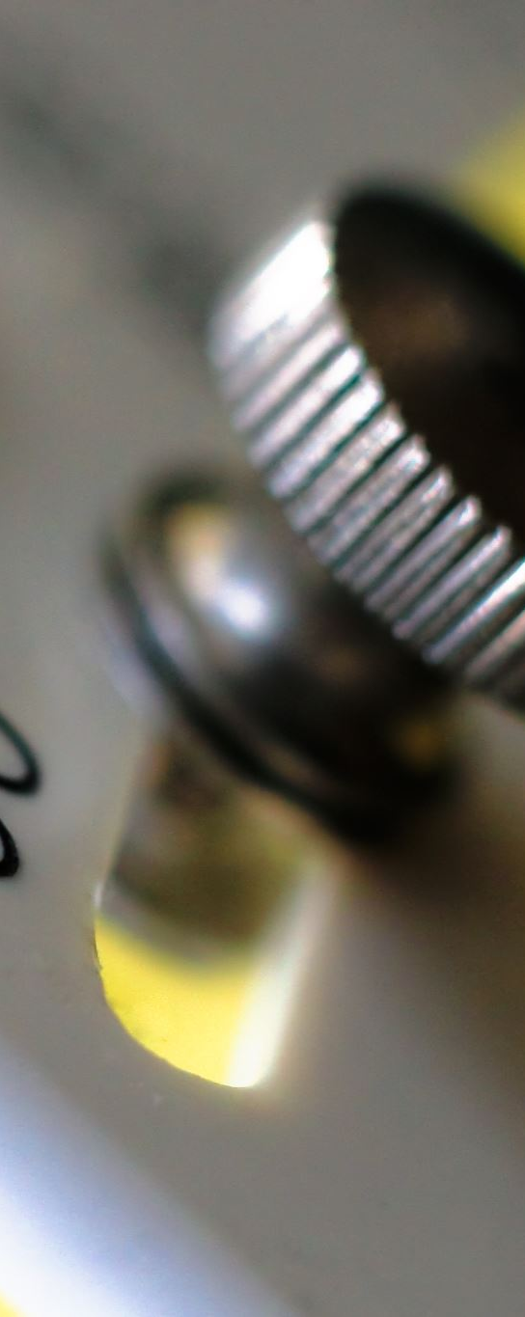
Sensor Classification
By Measurement Type: Temperature, Pressure, Proximity.
By Energy Requirements: Active (require external power) vs Passive (self-powered).
By Output Signal: Analog (continuous) vs Digital (discrete).
By Sensing Principle: Optical, Piezoelectric, Capacitive.

Slide 5
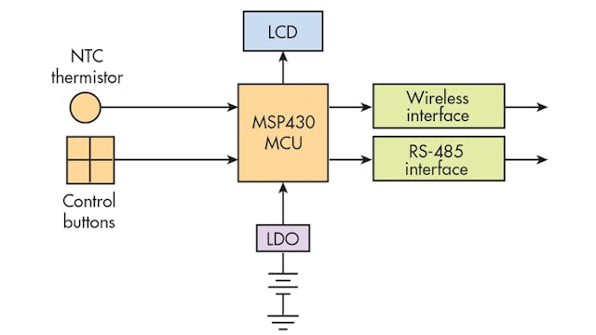
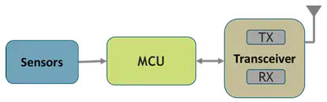
Sensor and MCU Integration
Data Collection: Sensors capture environmental data (e.g., temperature, pressure).
Processing: MCUs process data for analysis and decision-making.
Communication Protocols: I2C, SPI, UART for seamless interaction.
Analog Interface:
Uses ADCs to convert analog signals to digital for MCU processing.
Requires signal conditioning, such as filtering and amplification.
Example: Connecting a temperature sensor like LM35 to an Arduino for monitoring temperature changes.
Digital Interface:
Directly compatible with MCUs through GPIOs or communication protocols like I2C, SPI, UART.
Example: Using an ultrasonic sensor to measure distances in robotics.

Slide 6
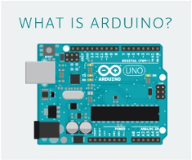
Arduino Framework
Open-source, user-friendly platform for rapid prototyping.
Key Features:
Supports analog and digital sensor interfaces.
Compatible with multiple communication protocols: I2C, SPI, UART.
Extensive library ecosystem for sensors and modules.
Tools:
Serial Monitor and Serial Plotter for real-time debugging.
Built-in IDE for code development and uploading.
Applications: Prototyping IoT devices, sensor-based systems, and automation projects

Slide 7
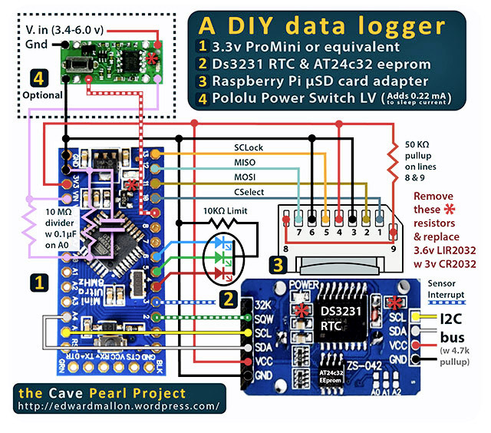
Data Logging Examples Using Arduino
Weather Stations:
Log temperature, humidity, and wind speed using sensors.
Timestamp data with an RTC module and store it on an SD card.
Applications: Climate research, real-time weather monitoring.
Environmental Monitoring:
Measure water quality (pH, turbidity) and soil moisture.
Supports sustainability and pollution studies.
Industrial Equipment Monitoring:
Attach vibration, temperature, and current sensors to log machinery performance.
Enables predictive maintenance.
Health Monitoring:
Record heart rate and body temperature data with wearable sensors.
Applications in remote healthcare and diagnostics.
Agriculture:
Monitor soil conditions and optimize irrigation.
Supports precision agriculture practices.

Slide 8
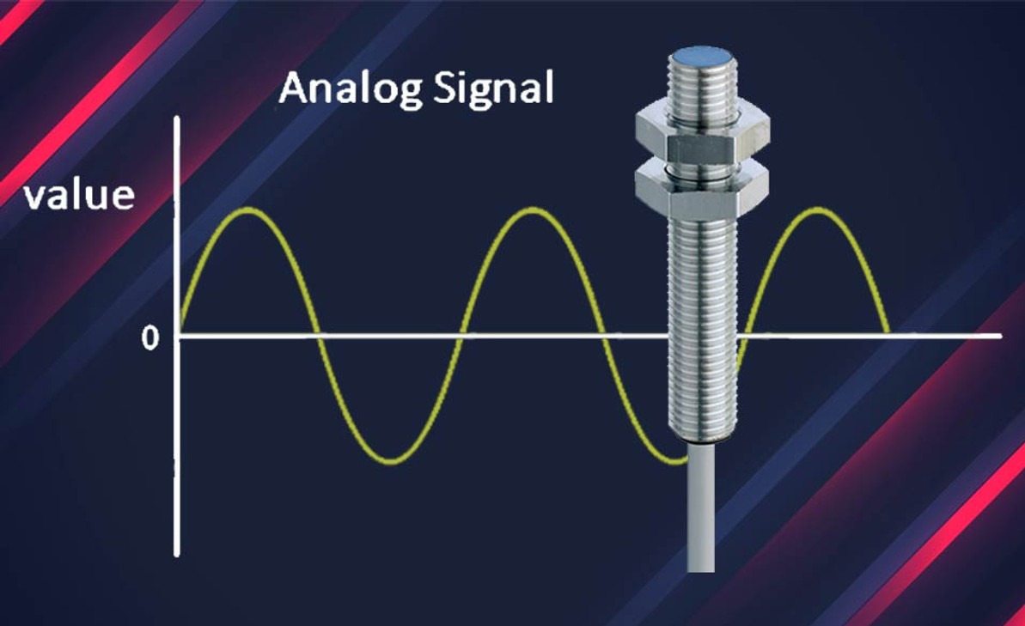
Analog Sensors
Produce continuous signals reflecting physical changes.
Examples: Temperature sensors, Pressure sensors, Light sensors.
Integration Requirements:
Signal conditioning: Amplification and filtering.
ADCs for converting continuous signals into digital formats.
Advantages:
Provide rich, detailed data.
Better suited for monitoring gradual changes over time.
Applications:
Environmental monitoring: Air quality, temperature, and humidity.
Medical diagnostics: ECG, EEG monitoring.
Audio processing: Microphone signals in sound systems.

Slide 9
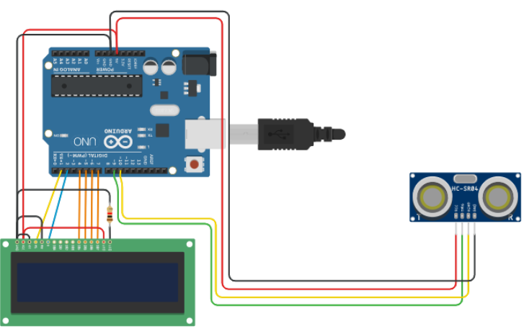
Digital Sensors
Output discrete signals (binary or serial data).
Examples: Proximity sensors, Digital temperature sensors, Motion detectors, GPS modules, Accelerometers, Digital Light Sensors, Tact switches, PIR Motion Sensors.
Integration Methods:
GPIO for simple on/off detection.
Communication protocols like I2C, SPI, UART for advanced data transfer.
Applications:
Industrial automation (robotics and conveyor systems).
Consumer electronics (smartphones and gaming controllers).
Automotive systems (proximity sensors for parking assistance).
Advantages:
High accuracy and reliability.
Noise immunity compared to analog counterparts.
Compact design and lower power consumption.

Slide 10

Sensor Application Examples - Smart Home Monitoring
Overview:
Combines sensors with MCUs to automate household systems for comfort, safety, and energy efficiency.
Components:
CO2, Temperature, and Humidity Sensors: Monitor indoor air quality.
Digital Light Sensor: Adjusts indoor lighting based on ambient conditions.
PIR Motion Sensor: Detects presence to manage lighting and HVAC systems.
AMG8833 TSA: Tracks room occupancy and adjusts climate control.
Sound Sensor: Triggers security alerts on unusual noise.
Functionality:
Ensures optimal air quality, lighting, and energy conservation.
Enhances security and responsiveness with automated systems.

Slide 11

Sensor Application Examples - Elderly Care Systems
Purpose:
Monitor health, safety, and activity of elderly individuals living alone.
Components:
PIR Motion Sensor and AMG8833 TSA: Track motion and body heat.
Sound Sensor: Detects distress sounds for emergency alerts.
CO2, Temperature, and Humidity Sensors: Maintain environmental safety.
Emergency Button: Manual alert system for caregivers.
Functionality:
Real-time monitoring of activity and environment.
Alerts caregivers during emergencies or unusual activity.

Slide 12

Sensor Application Examples - Smart Agriculture
Purpose:
Improve crop yield and resource efficiency through environmental monitoring.
Components:
CO2, Temperature, and Humidity Sensors: Optimize greenhouse conditions.
Water Sensor: Automates irrigation based on soil moisture levels.
Digital Light Sensor: Adjusts lighting for plant growth.
PIR Motion Sensor: Detects animal intrusions near crops.
AMG8833 TSA: Identifies pest and disease hot spots.
Functionality:
Monitors and adjusts for ideal growing conditions.
Reduces waste and improves productivity through automation.

Slide 13
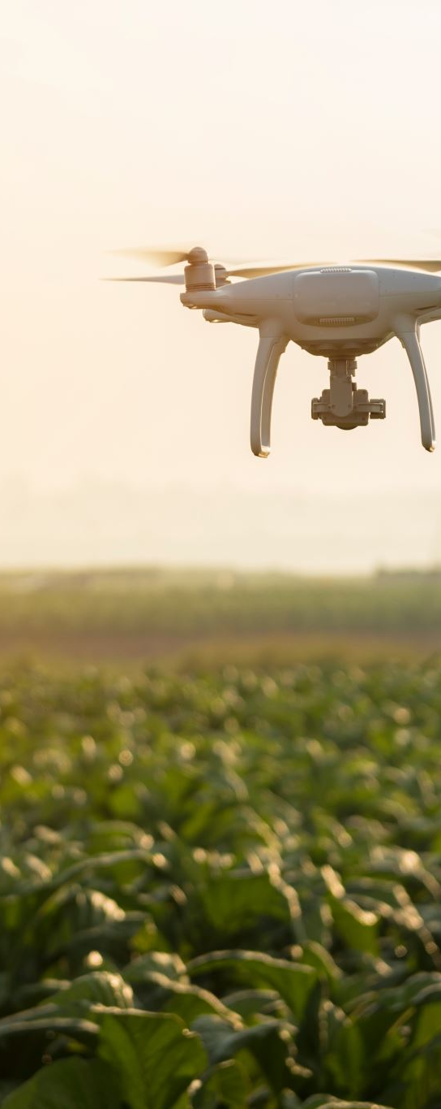
Summary
Sensors are crucial for detecting and processing environmental data.
Analog and digital sensors cater to specific needs with unique integration techniques.
Applications include healthcare, agriculture, automation, and smart homes.

